Slide 1

Should we continue working with HDBs?
An analysis on the HDB Market
by Kenneth Chen

Slide 2
Covid-19 hurts
We, Propseller, are a real-estate agency in Singapore.
The pandemic’s effects are far and wide. In these trying times, it’s important that we reconsider our limited budget.

Slide 3

Are HDBs worth?
Market research, staff and advertising are just a few things we pay for. It’s vital that we stop pursuing strategies that aren’t profitable.
There are many ideas that can help the budget; we’ll be looking at one today. The focus of this analysis is to determine if it’s a good idea:
To stop working with HDBs?

Slide 4

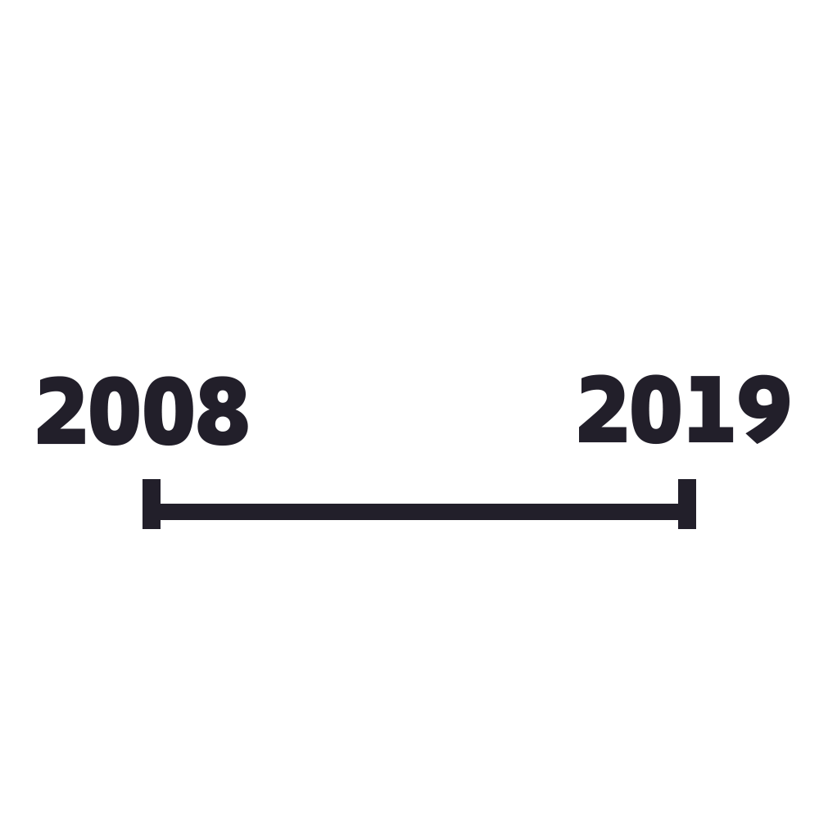
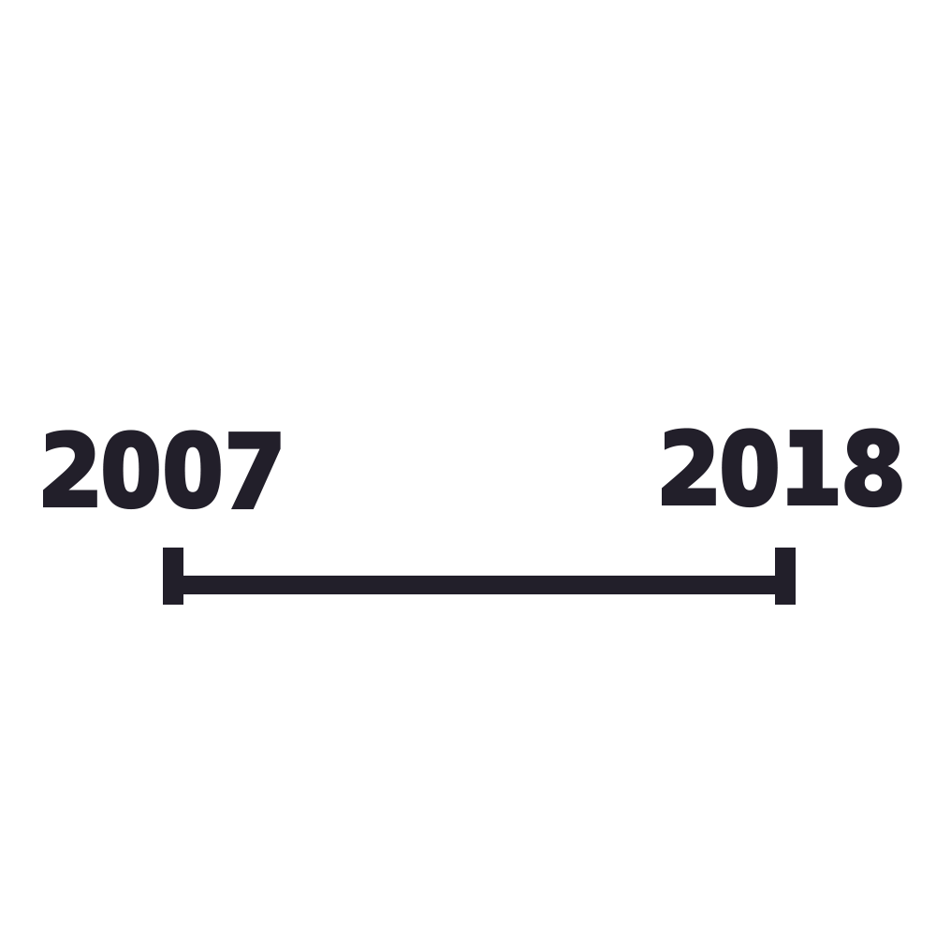
Cumulative HDBs built
Proportion of population living in HDBs
financial_year – class <date> – years 2008-2019
dwelling type – class <str> – HDB, DBSS
no_of_units – class <int> – discrete
25 rows
financial_year – class<date> – year 2007-2018
type – class<str> – HDB flats, Sold flats
percentage_of_pop_in – class<int> – percentage
25 rows

Slide 5
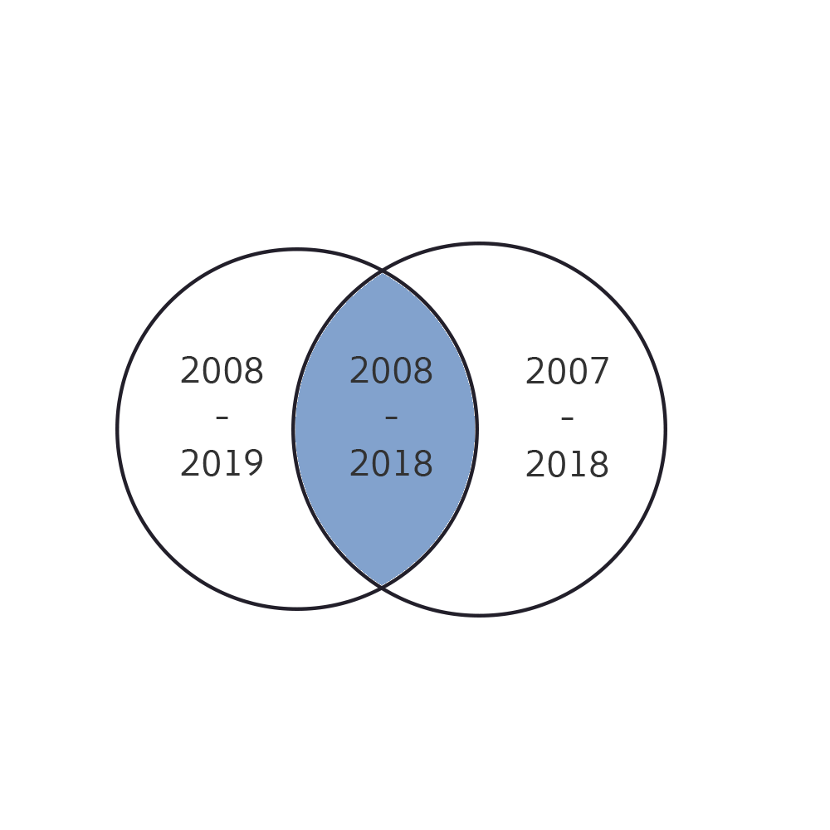
data processing
Filtered out ‘DBSS’ using numpy filter.
Coverage periods are not the same. As a result, set intersection was used to determine the financial years that exist in both datasets.

Slide 6
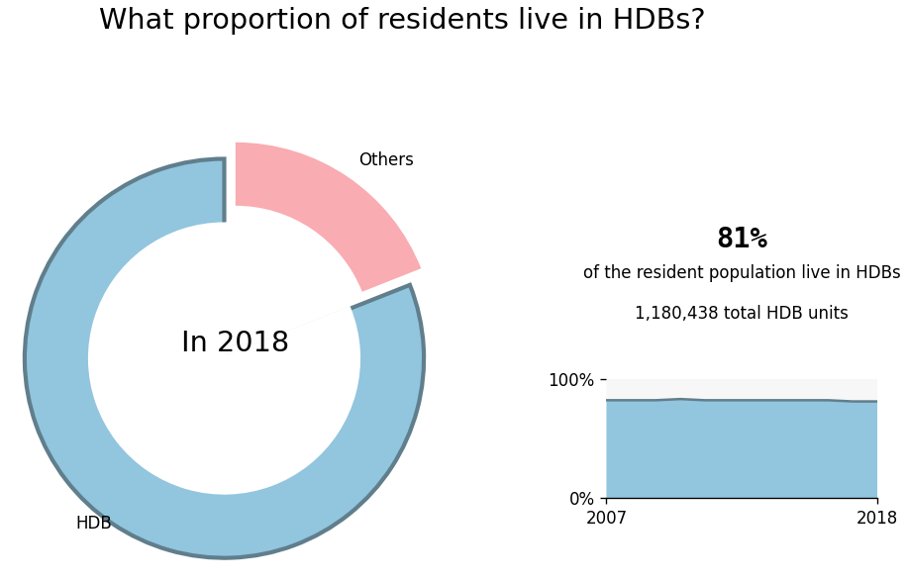
HDBs have the largest consumer base. We will miss out on 81% of residents if we decide to stop working with HDBs.

Slide 7
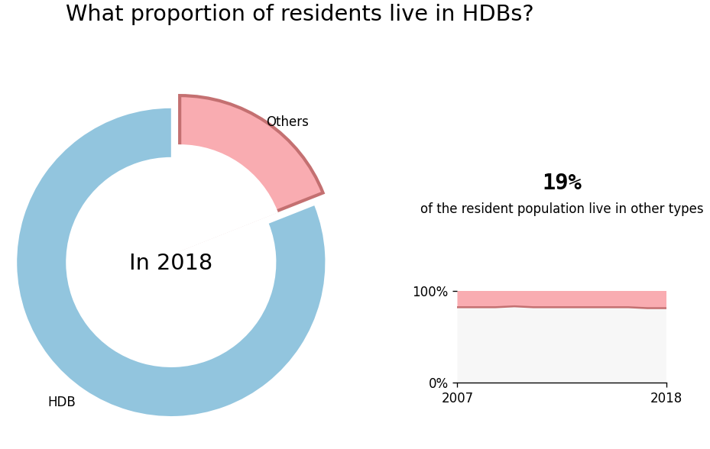
Other types only occupy 19% and over the past years this figure has stayed the same.

Slide 8
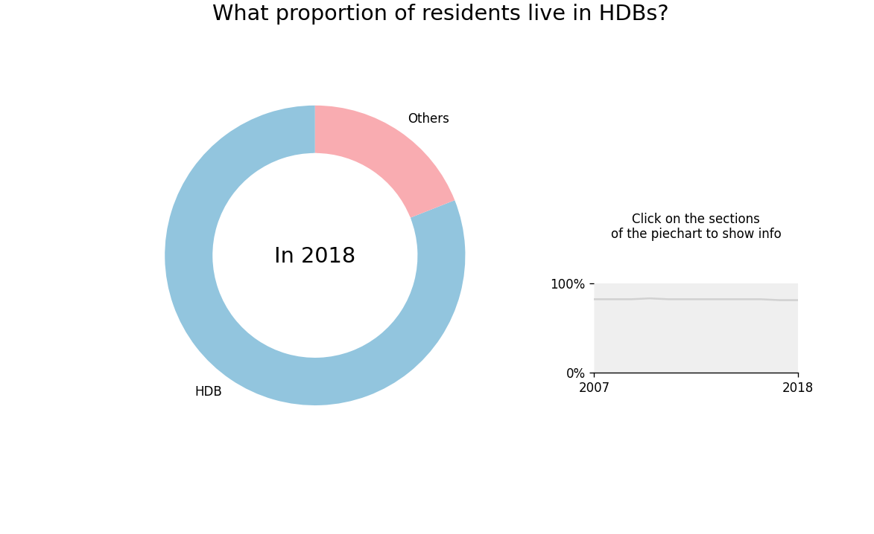
plt.text
plt.pie
plt.plot
Inner plt.pie with white color
plt.stackplot
matplotlib.ticker.PercentFormatter

Slide 9

Resale flat prices
Three datasets, each covering a different time period.
resale_flat_prices_2012_2014.csv
2012-2014
52,204 rows
resale_flat_prices_2015_2016.csv
2015-2016
37,154 rows
resale_flat_prices_2017_2021.csv
2017-2021
115,874 rows
Same columns across all three datasets
uncleaned columns:
month, town, flat_type, block, street_name, storey_range, floor_area, flat_model, lease_contract, resale_price

Slide 10
data processing
Filtered unused columns using numpy filter
‘month’, ‘town’, ‘floor_area_sqm’, ‘resale_price’
resale_flat_prices_all.csv
month – class <date> – year-month
town – class <string> – town name
floor_area_sqm – class <int> – meters
resale_price – class <int> – SGD
205,230 rows
Merge the three datasets using np.concatenate the columns
np.savetxt the cleaned and merged data to new csv
resale_flat_prices_all.csv

Slide 11
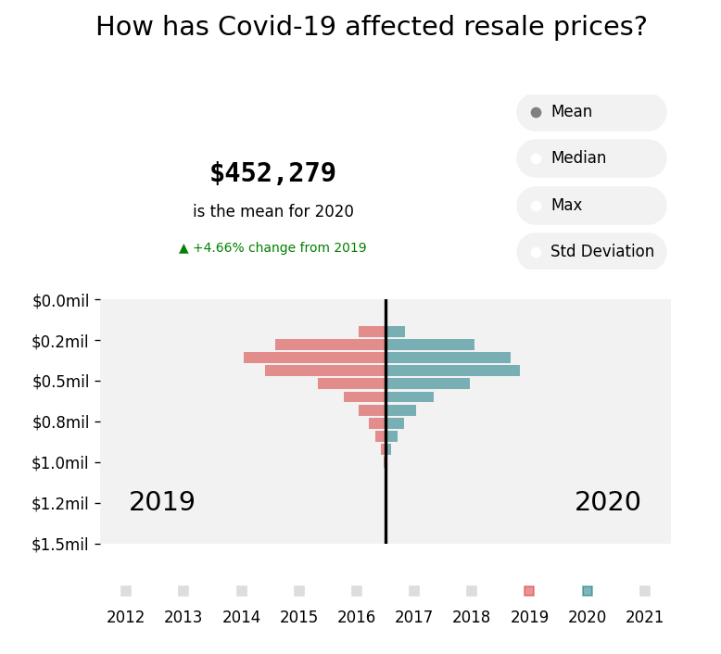
Distribution of prices shifts slightly towards a more expensive side.
First year of pandemic increased the average price +4.66% compared to the previous year, 2019 vs 2020.

Slide 12
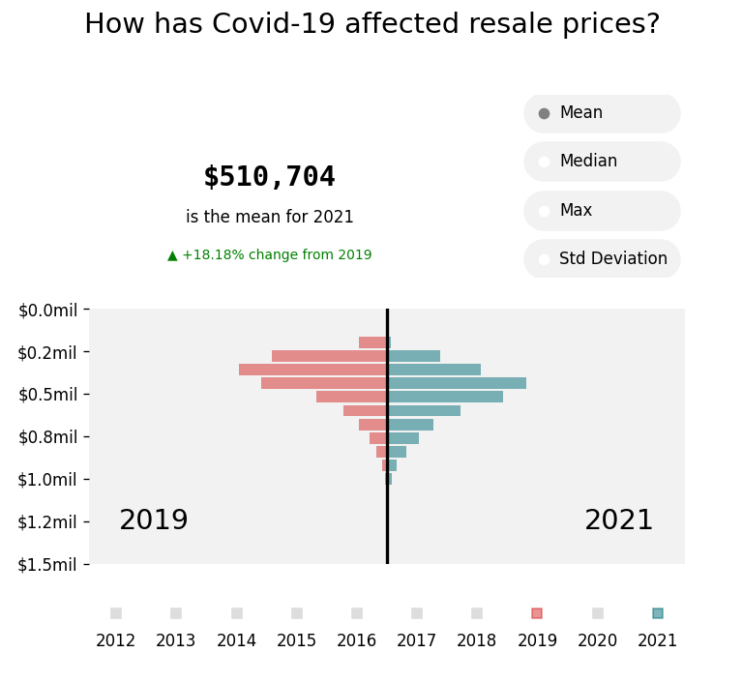
Much larger shift in distribution of prices.
+18.2% increase in the mean resale price, 2019 vs 2021.
Construction delays(due to manpower shortage from Covid-19 border measures) increased demand for resale flats. (Ng, 2021)
Residents buying resale flats can receive up to $160,000 in grants, thus people can afford more expensive property. (Ng, 2021)
Resale prices are higher than normal, potentially more profit for us.

Slide 13
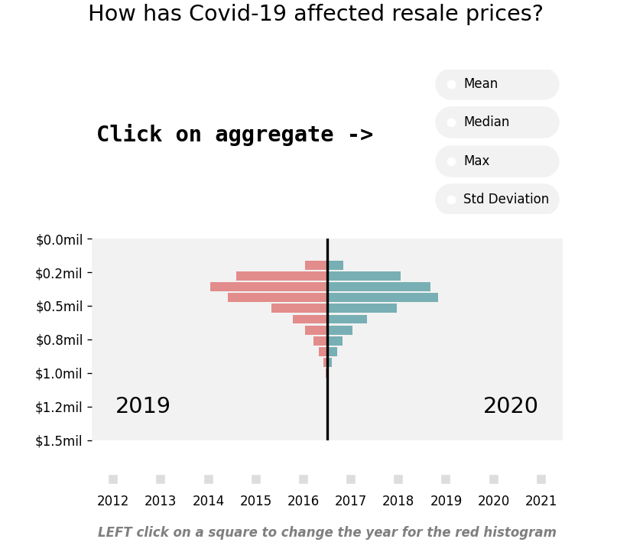
plt.plot
np.mean
plt.text
np.median
np.max
np.std
plt.yaxis.set_major_formatter
plt.hist
plt.annotate
(for hover annotations)
plt.plot

Slide 14
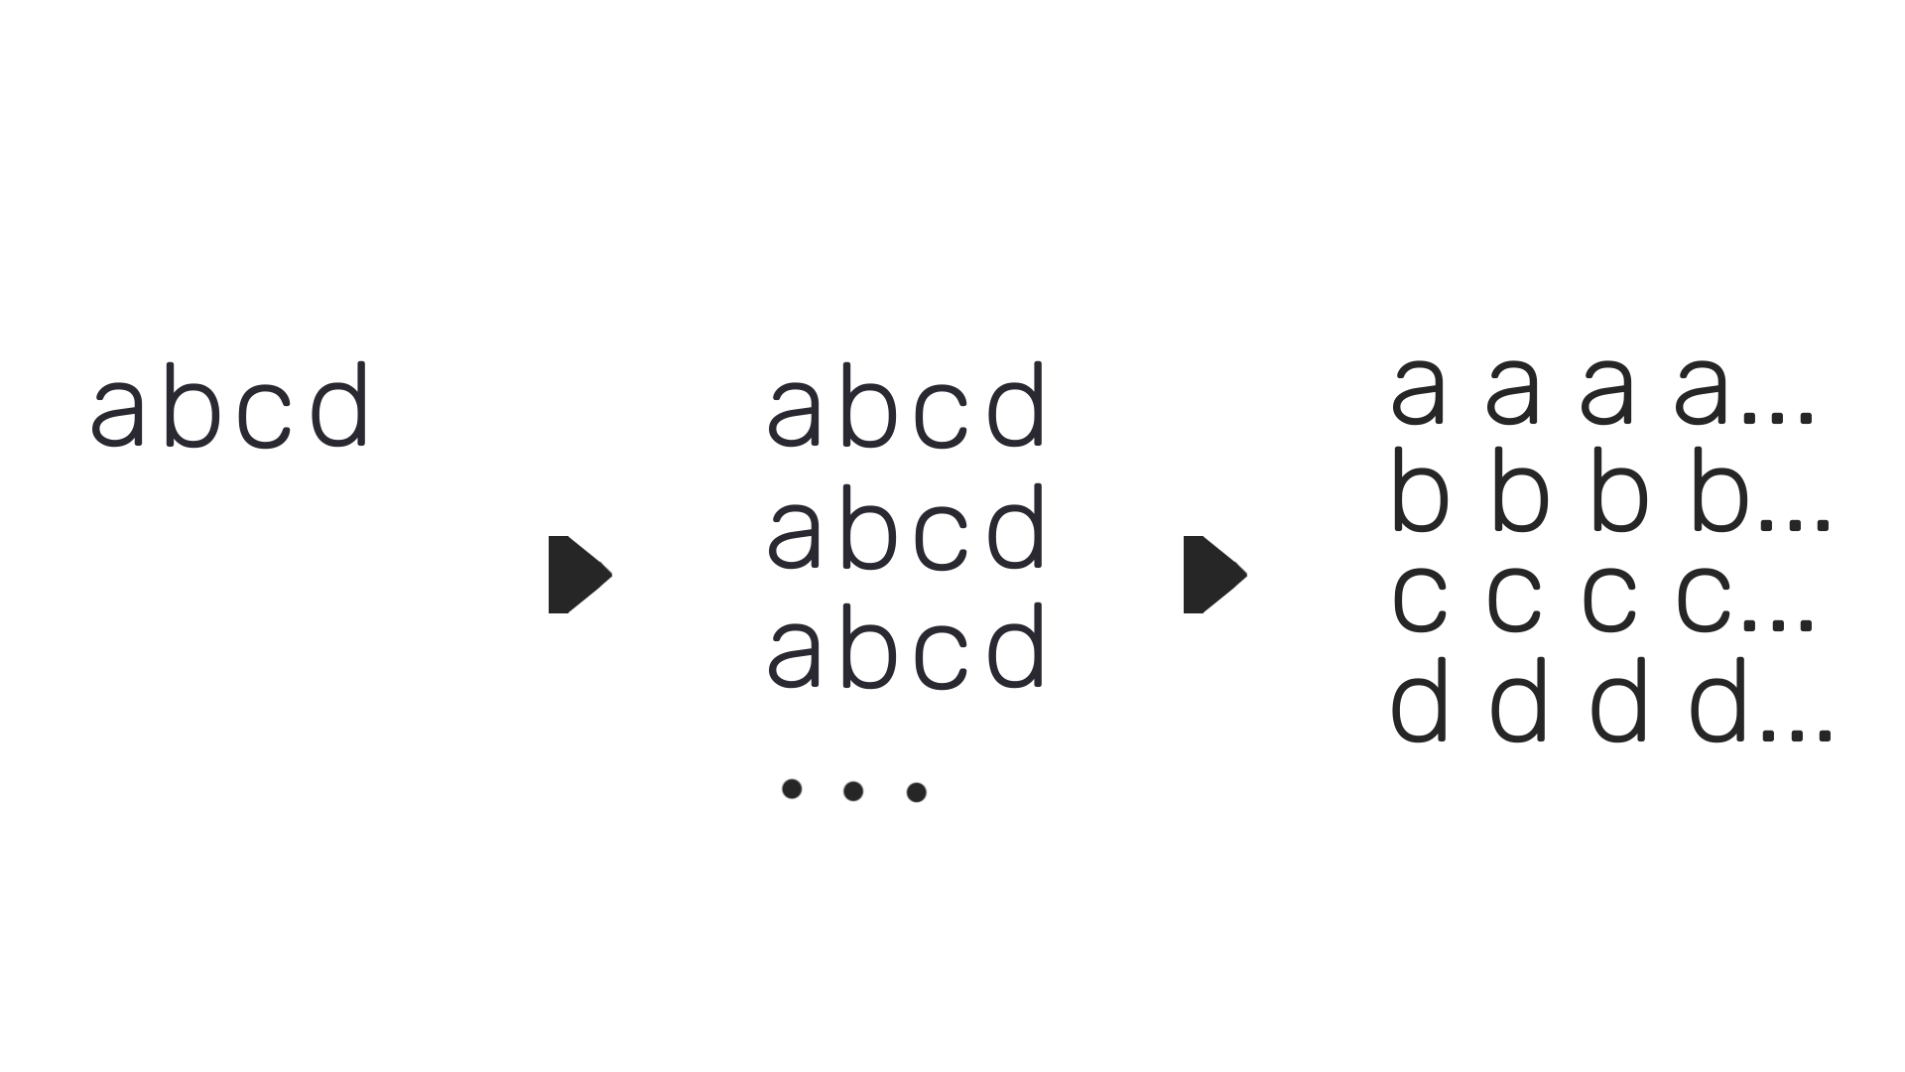

Covid and sales processing
Processing for seasonal adjustment
transformed
months to quarter
2020-03 to 2020-Q1
np.resize
np.transpose

Slide 15
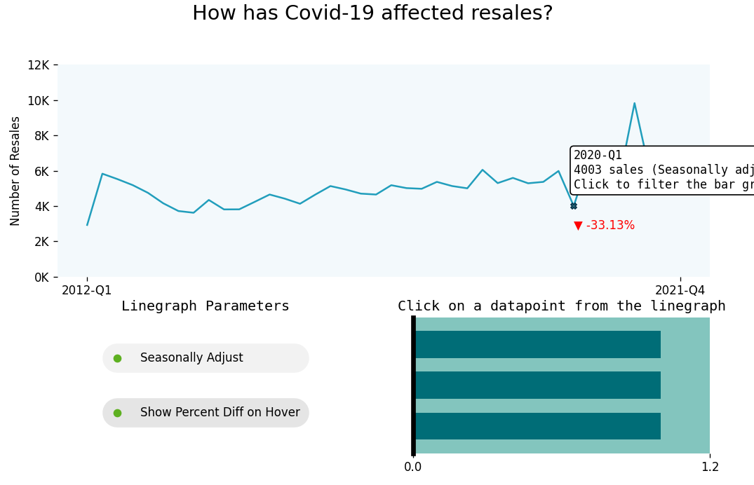
After seasonal adjustment, -33.13% dip in resales from 2019.
Possibly due to tight circuit breaker measures implemented in April. (Lee, 2020)

Slide 16
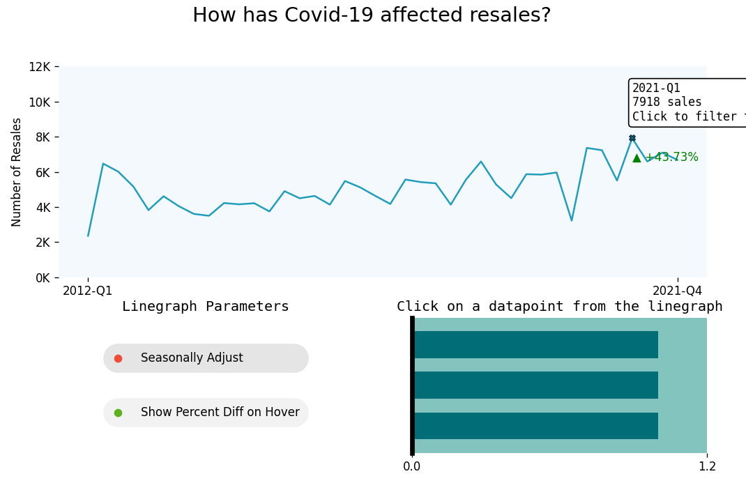
Fast recovery in one year, reaching a 9-year high of 7918 resales in 2021-Q1.
Number of resales are higher than ever; it seems like a great time to capitalise on this.

Slide 17
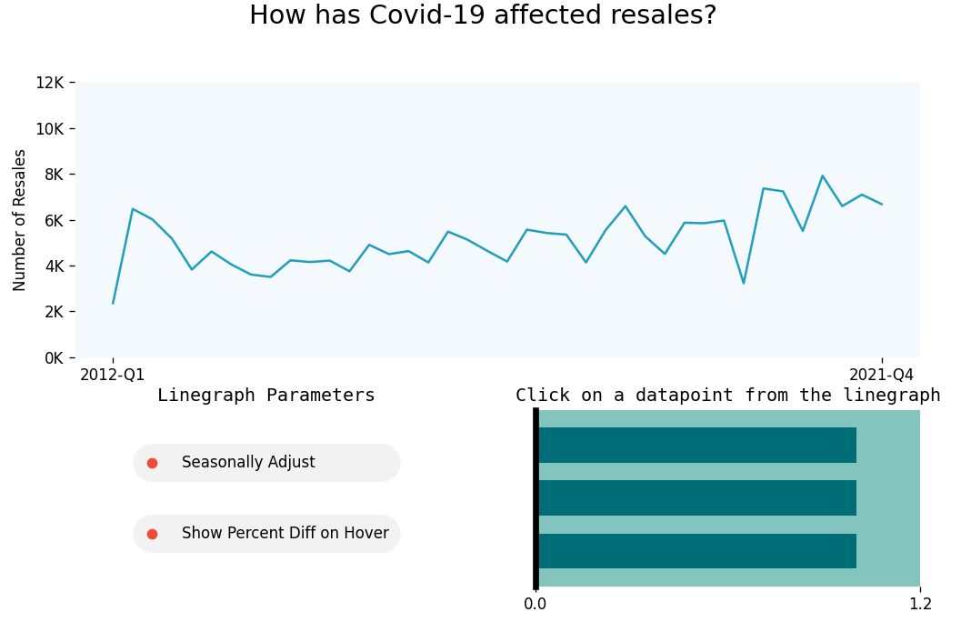
plt.yaxis.set_major_formatter
plt.plot
plt.annotate
(for hover annotations)
plt.set_ylabel
plt.set_yticks
plt.set_xticks
plt.barh
plt.text
plt.plot
ax.spines

Slide 18

Resales by location
‘\planning_area_shape'
Read shape data file using Python library geopandas
HDB considers towns: Marina East, Marina South, Newton, Orchard, Outram, River Valley as Central Area. (Housing & Development Board, 2020).
Merged the above regions into one larger region ‘Central Area’.
Kallang and Whampoa also merged.
Merging was done with shapely
shapely.ops.unary_union

Slide 19
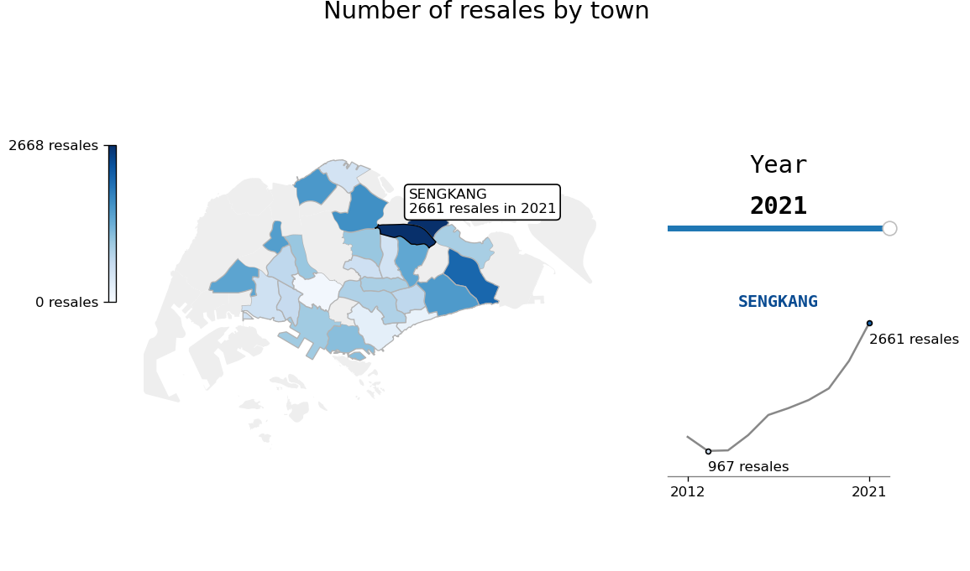
Over the years, towns in the central region do not appear to perform well.
Meanwhile, towns farther away from the central region such as the east are producing incredible results.
From historical performance, the number of resales in Sengkang continue to grow, reaching an impressive 2661 resales in 2021.
We should avoid towns in the central region when it comes to HDBs.

Slide 20
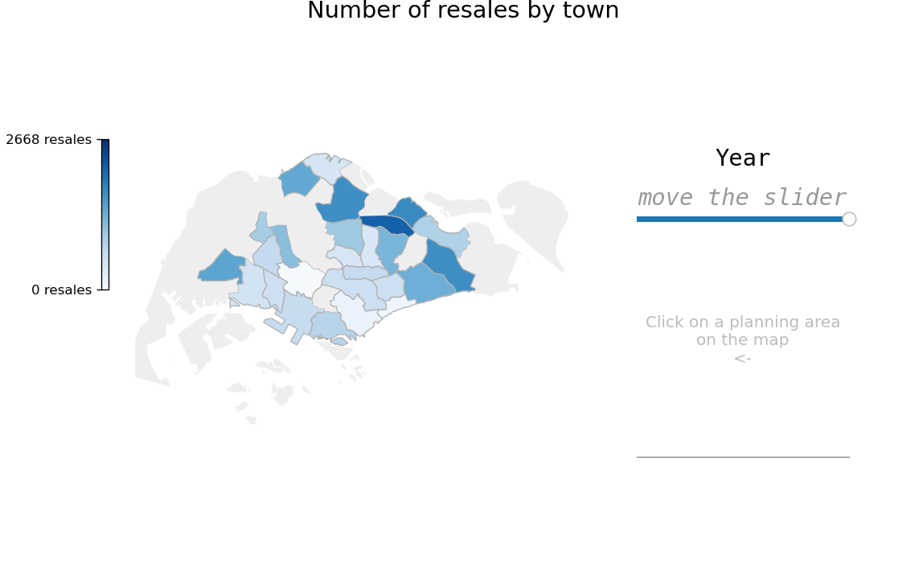
plt.fill
matplotlib.widgets.Slider
plt.imshow
plt.colorbar
plt.text
plt.plot
(for line graph)
plt.cm.Blues

Slide 21
Completion status
financial_year – class <date> – year, 2008 to 2019
town_or_estate – class <str> – names of towns
hdb_or_dbss – class <str> – “hdb”, “dbss”
status – class <str> – “under construction”, “completed”
no_of_units – integer
1101 rows
Filtered out “DBSS” using numpy filter

Slide 22
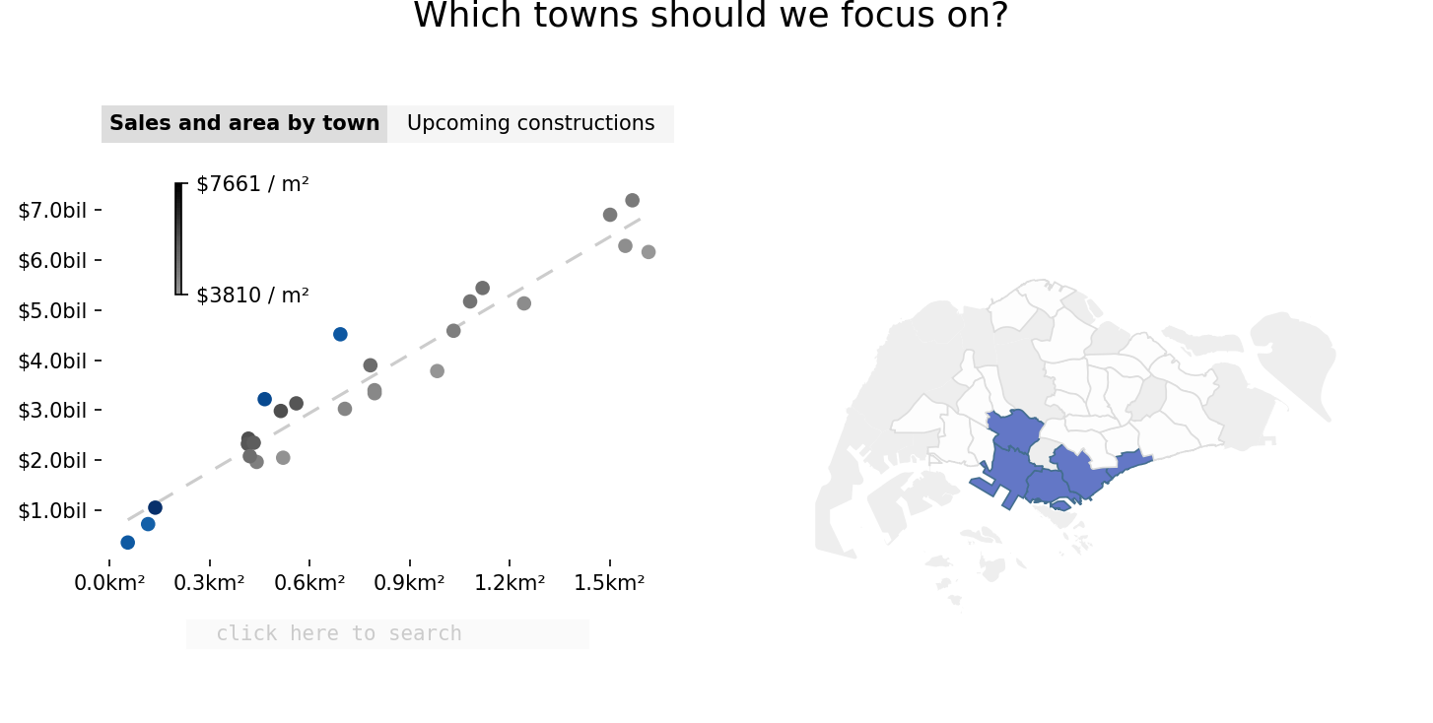
Towns close to the central area have higher property values. It is reasonable to assume that advertising rates will be more expensive in these highly priced areas.
The expensive advertising is not worth it. None of the central towns are top performers in total sales.

Slide 23
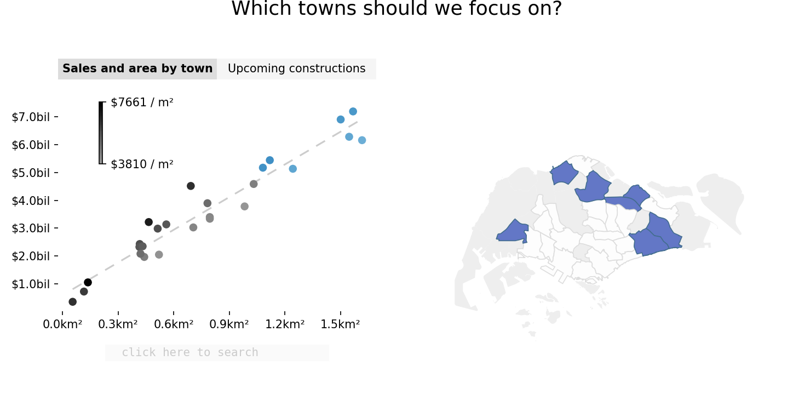
Towns farther away from the central region perform better.
The east side in particular boasts not only impressive performance, but potentially cheaper advertising rates as well, as their price per meter squared is on the lower side.

Slide 24
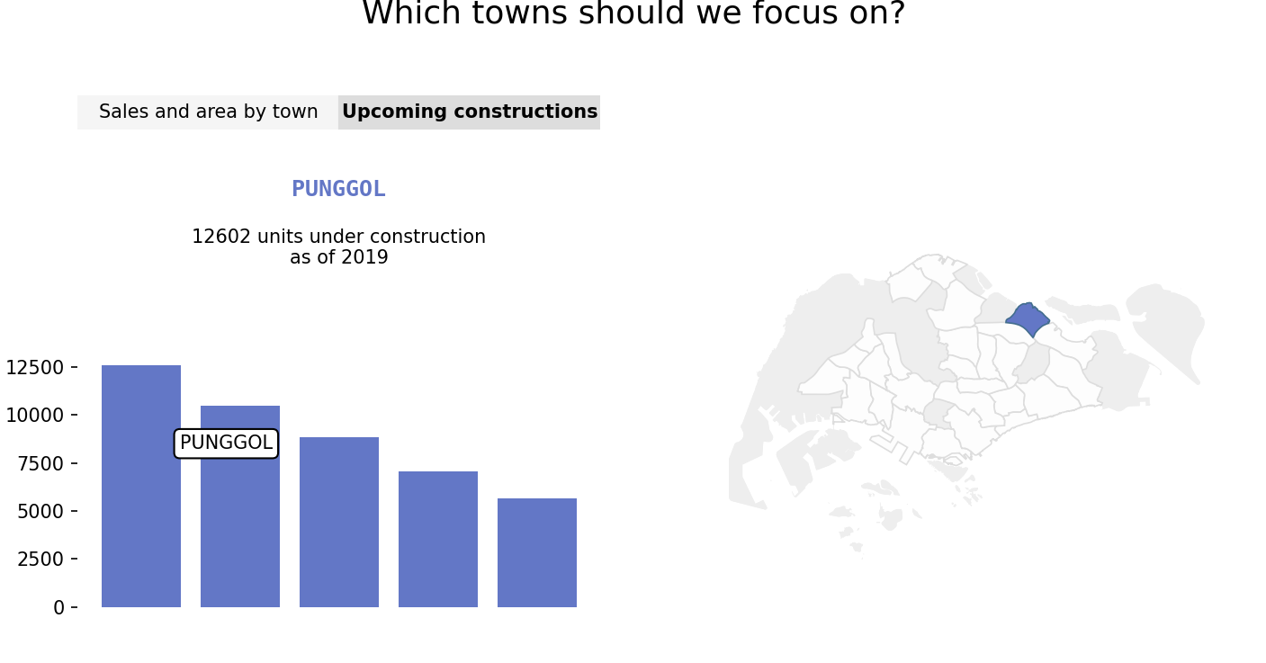
Punggol, Tampines, Tengah and Sengkang are the towns with the most units under construction as of 2019.
We can start advertising and building trust in these towns early on, to increase our success once these constructions go for resale.

Slide 25
Conclusion
It is worth to continue working with HDBs. The market conditions are great, and it continues to remain as the popular choice of housing.
However, just as importantly, we should avoid investing resources on towns that do not produce results.

Slide 26
Dataset sources
'cumulative_hdb.csv'
- https://data.gov.sg/dataset/cumulative-units-completed-since-1960
'completion_status.csv'
- 'https://data.gov.sg/dataset/number-of-units-of-hdb-developments-by-status?resource_id=7152faf5-c6db-44f7-92ec-9b4874b24d6f’
‘\planning_area_shape'
- 'https://data.gov.sg/dataset/planning-area-census2010’
'resale_flat_prices_2012_2014.csv'
'resale_flat_prices_2015_2016.csv'
'resale_flat_prices_2017_2021.csv'
- https://data.gov.sg/dataset/resale-flat-prices
'hdb_percent_of_population.csv'
- 'https://data.gov.sg/dataset/estimated-resident-population-living-in-hdb-flats?resource_id=a7d9516f-b193-4f9b-8bbf-9c85a4c9b61b'

Slide 27
References
Ng, M., 2021. BTO flat buyers affected by Covid-19 construction delays may be able to cancel booking without penalties. [online] The Straits Times. Available at: <https://www.straitstimes.com/singapore/housing/bto-buyers-affected-by-delays-may-be-able-to-cancel-flat-booking-without-penalties> [Accessed 2 January 2022].
Lee, H., 2020. PM Lee Hsien Loong on the COVID-19 situation in Singapore on 21 April 2020. [online] Prime Minister's Office Singapore. Available at: <https://www.pmo.gov.sg/Newsroom/PM-Lee-Hsien-Loong-address-COVID-19-21-Apr> [Accessed 2 January 2022].
Housing & Development Board. 2022. HDB | Central Area. [online] Available at: <https://www.hdb.gov.sg/cs/infoweb/about-us/history/hdb-towns-your-home/central> [Accessed 3 January 2022].

